Slide 1
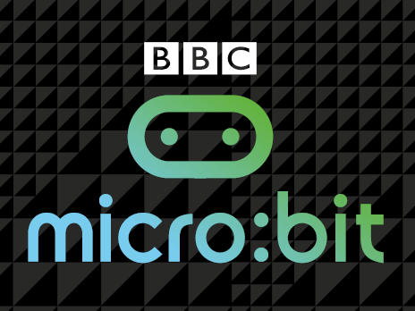
BBC micro:bit

Slide 2
Starter
Find out what a BBC micro:bit is.
Find out what companies made the micro:bit
Video
Micro:bit website: https://microbit.co.uk

Slide 3
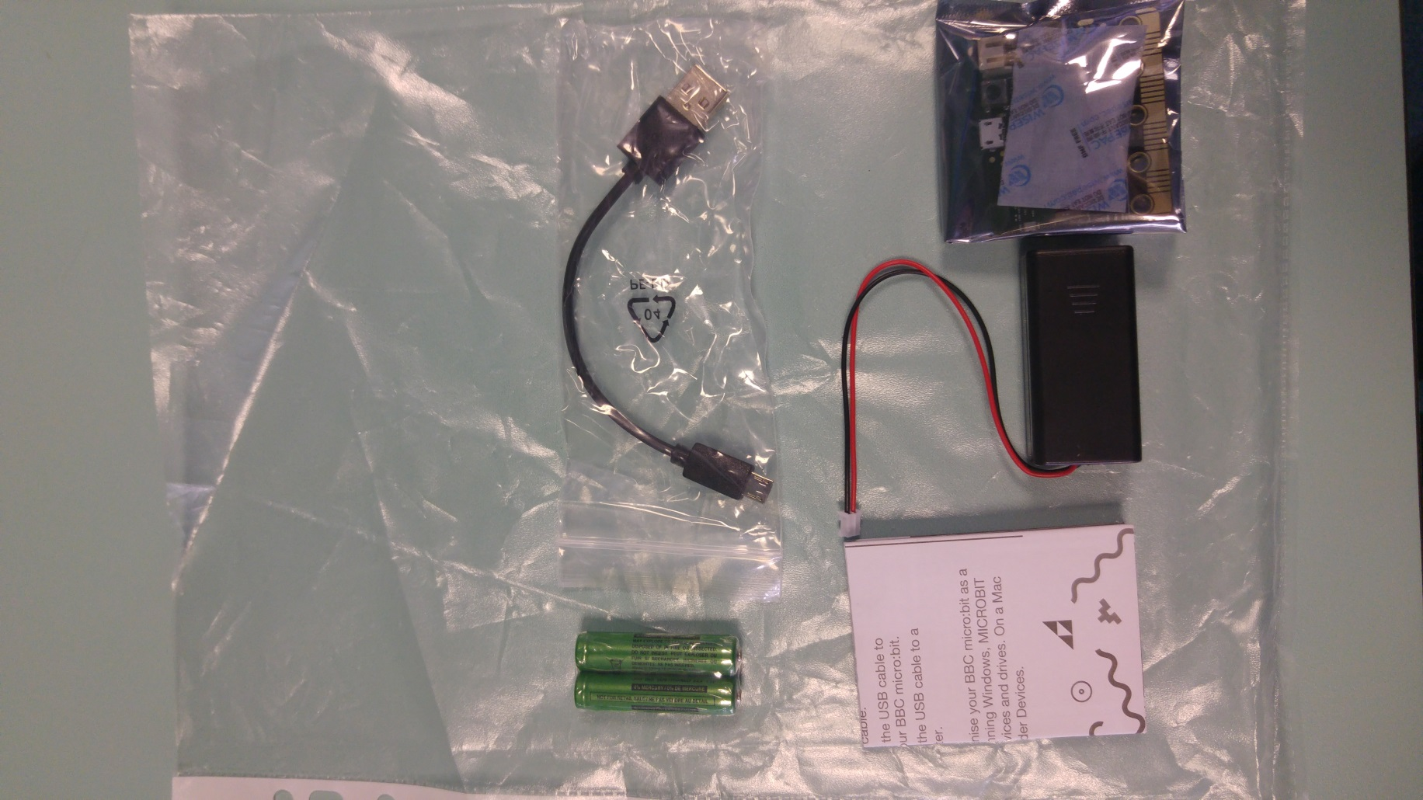
Collect your micro:bit
These micro:bit’s are yours to keep however they will be kept in school until the end of term
You should have everything in the image to the right
Please put your name and class on the sticker

Slide 4
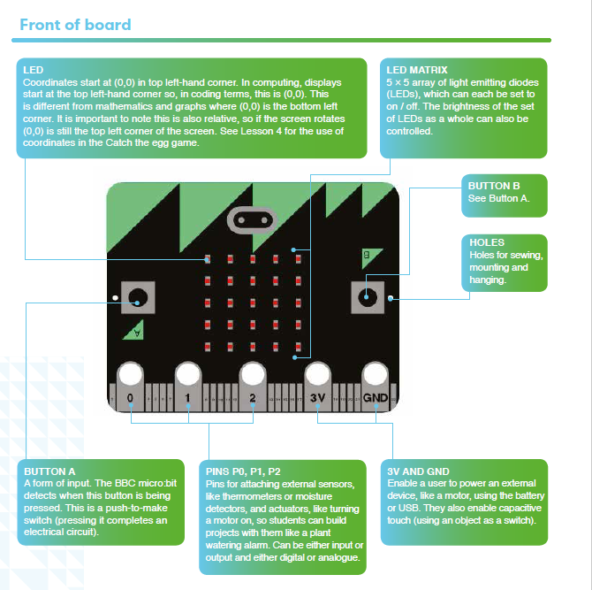
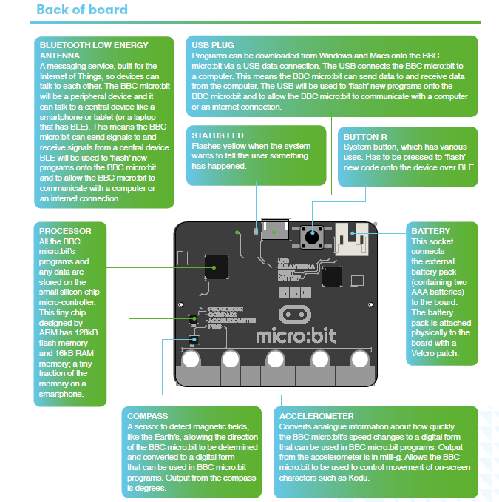
The micro:bit hardware

Slide 5
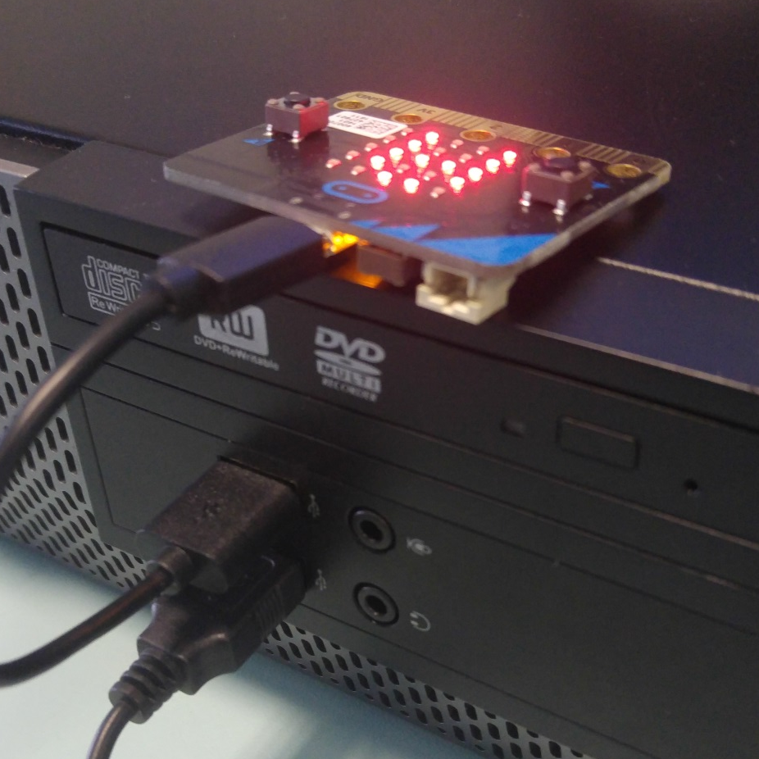
Hello, World!
Plug your USB cable into your computer and micro:bit
Run through setup
Go to http://microbit.co.uk/app/
Click Create Code
Click MicroPython

Slide 6
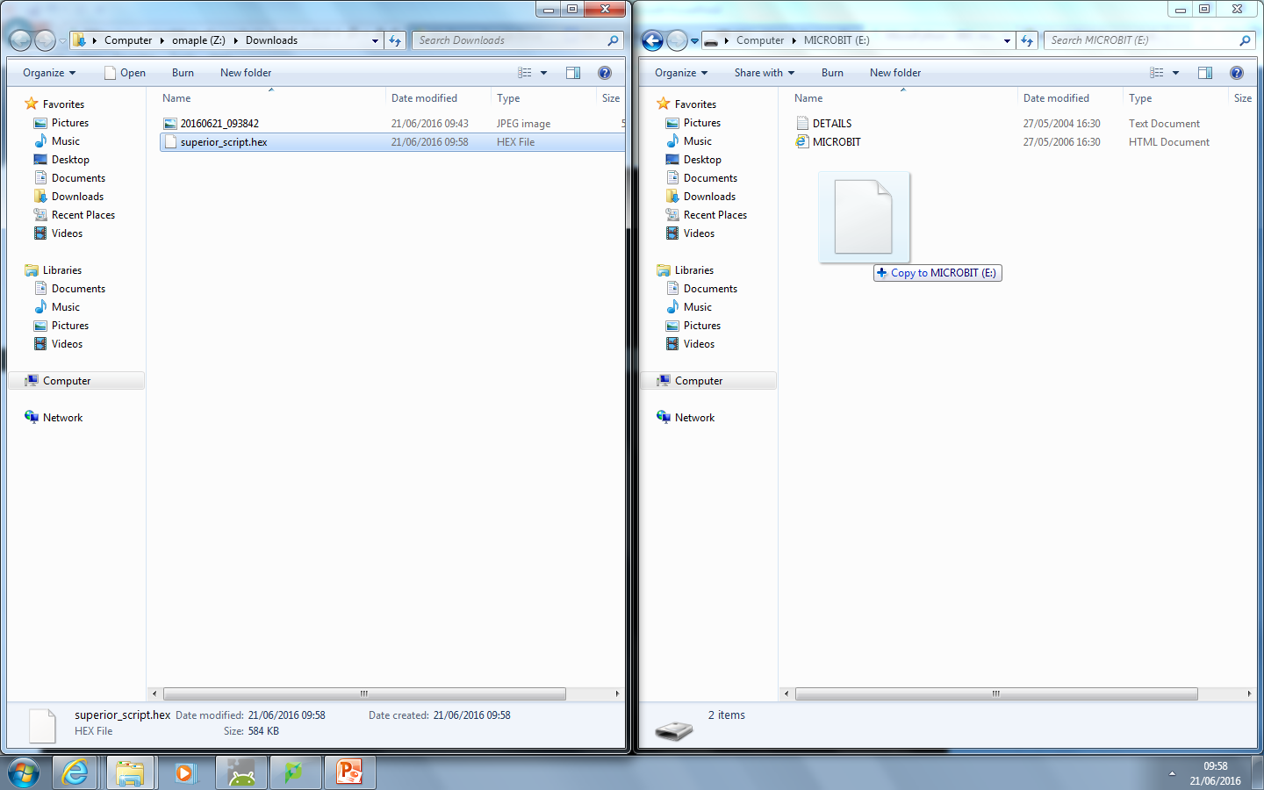
Hello, World!
Click Download
Move file to micro:bit (see image below)

Slide 7
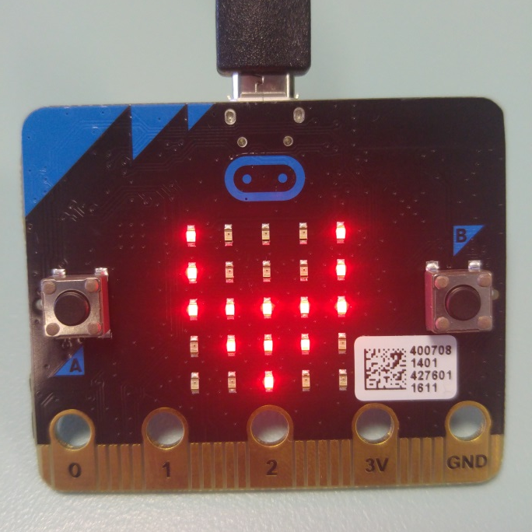
Documentation
The BBC has provided documentation to help you code your micro:bit with Python
Go to http://bit.ly/microbit-docs
Have a look through the pages
Task:
How would you create a COW Image?
The text after “Image.” should always
be all-caps

Slide 8
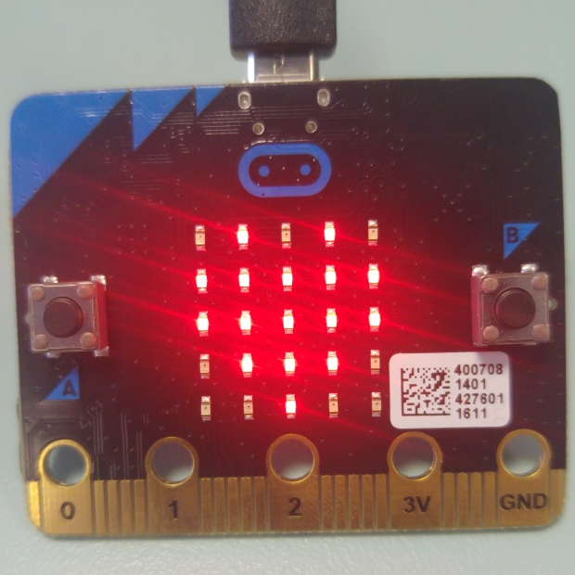
Getting Started Task
To start with you need to create a program that:
Displays the HEART image when idle
Displays any text when button A is pressed
Displays any text when button B is pressed
Has a 5 second delay between output and reset
Extension task - Display text once upon startup
Solution: http://bit.ly/microbit-start

